Slide 1
Class 02: EDA and Jupyter Wednesday, January 16
INFO 3402: Information Expositions Professor Brian Keegan brian.keegan@colorado.edu

Slide 2
Agenda
11:00 – 11:05 → Introduce your dataset and question
11:05 – 11:40 → Load your dataset up into Jupyter and run through EDA checklist
11:40 – 11:50 → Recap and review

Slide 3
Characteristics of a good question
Question should be of interest to audience
Question should not already been answered
Question should be plausible
Question should be answerable
Question should be specific
From Peng & Matsui (2018). The Art of Data Science.

Slide 4
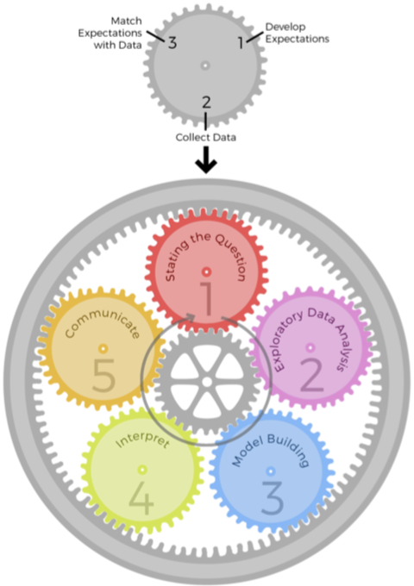
Epicycles of Analysis
 | Set expectations | Collect information | Revise expectations
Question | Question is of interest to audience | Survey literature and experts | Sharpen question
EDA | Data are appropriate for question | Make exploratory plots of data | Refine question or collect more data
Modeling | Primary model answers question | Fit secondary models, sensitivity analyses | Revise model to include other predictors
Interpretation | Specific and meaningful answer to question | Focus on effect sizes, uncertainty | Revise analysis to provide meaningful answers
Communication | Results are understood and meaningful to audience | Seek feedback | Revise analyses of approach to presentation
From Peng & Matsui (2018). The Art of Data Science.

Slide 5
Introduce your data set
What is the data set?
Where did it originally come from?
How is the data shaped?
Why do you want to analyze this data?

Slide 6
My data set
What is the data set?
House Office Expenditure Data for Q3 of 2018
Where did it originally come from?
House of Representatives, but cleaned up and standardized by the Sunlight Foundation/ProPublica
How is the data shaped?
1 file, 17.7MB,
Why do you want to analyze this data?

Slide 7
Housecleaning and launch Jupyter
Maybe it’s been a while since you’ve launched Jupyter/Anaconda → it’s time to update
Create a directory where you will keep all your notebooks and data for this class
After downloads and installation, launch Jupyter, start a new notebook and load your data with pandas
Write down your question/hypothesis at the top of the notebook
$ conda update --all

Slide 8
Exploratory data analysis checklist
Formulate your question → see “Characteristics of a good question”
Read in your data → Is it properly formatted? Perform cleanup activities
Check the packaging → Make sure there are the right number of rows & columns, formats, etc.
Look at the top and bottom of data → Confirm that all observations are there
Check the “n”s → Identify “landmark” values and to check expectations (number of states, etc.)
Validate against an external data source → Right order of magnitude, expected distribution, etc.
Make a plot → Checking and creating expectations about the shape of data and appropriate analyses
Try an easy solution → What is the simplest test for your question?
From Peng & Matsui (2018). The Art of Data Science.

Slide 9
Next classes
Friday: Out-of-town
Aaron Jiang (INFO Ph.D. student) will be sharing his work on “Classifying Post-mortem Content on Social Media”
Read paper before Friday, Aaron will share history of challenges with getting this paper published
Under “Week 01 Presentation” submit a link with an example of an article, blog, tutorial, etc. using data analysis
Readings (for next week) → On Canvas
Frankfurt, H. “On Bullshit.”
Social Research Methods. ”Introduction to Validity.”
Medium. “Becoming a Publishing Workflow Expert.”
Other documentation, tutorials, and resources available on Canvas

